Slide 1
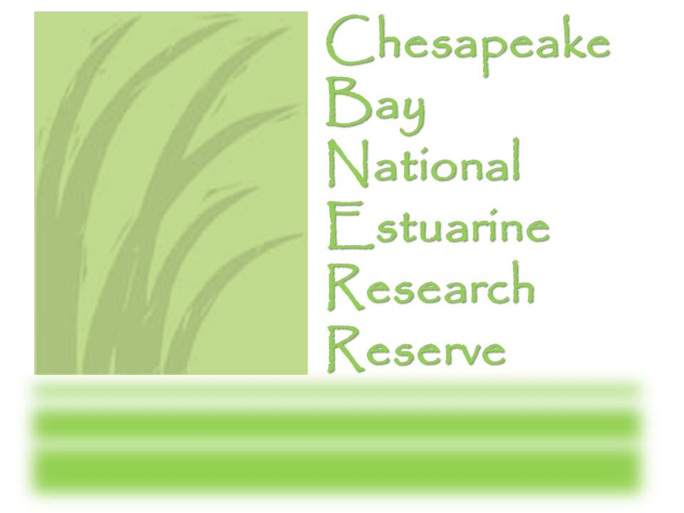
VA SEA Virginia Scientists & Educators Alliance: Graduate Level Research Translated for K-12 Classrooms
Lisa Lawrence
Education Leader VIMS Marine Advisory Program
Carol Hopper Brill Marine Education Specialist
VIMS Marine Advisory Program
Notes:
Hi everyone! Thank you so much for joining the NERRS Science Collaborative webinar today to learn about Building Research Skills in K12 Education. I’m thrilled to be sharing some of my Science Collaborative-funded projects and how these projects have really been able to connect real science with our local students. Before we start, I just want to acknowledge that these projects would not have been possible without many partners, especially the VIMS Marine Advisory Program and Virginia Sea Grant educators who were all collaborators and creators of the firs tproject I’m going to share with you!

Slide 2
Why communicate science?
Graduate students are preparing for two careers:
*Research Scientist
&
*Science Communicator
The public needs
to become more knowledgeable
about science.
Scientists need to become
much more involved with
and knowledgeable about
the public as learners.
⇦
⇦
Scientists as educators
Notes:
So first of all, before we get to the specific programs, we need a little background about why we are doing these types of programs. There has been a ton of research showing that Americans have a lower understanding of science, or scientific literacy, than many other countries. There are abundant efforts to increase STEM programs in schools, and this is also reflected in the knowledge level of the general public. With the release of the Next Generation Science Standards in 2013, there was a significant need for teaching resources and professional development that assist teachers in better demonstrating to their students the research practices of scientists and how they apply critical thinking skills. The best source of authentic and current research examples is scientists themselves.
At the same time, we also know that scientists can’t live in isolated bubbles, conducting their research without connecting it to the greater good, so they may need some training and encouragement to become involved in translating scientists. Basically, we want our scientists to be educators, b/c where else should people learn about science but directly from those conducting it every day.

Slide 3
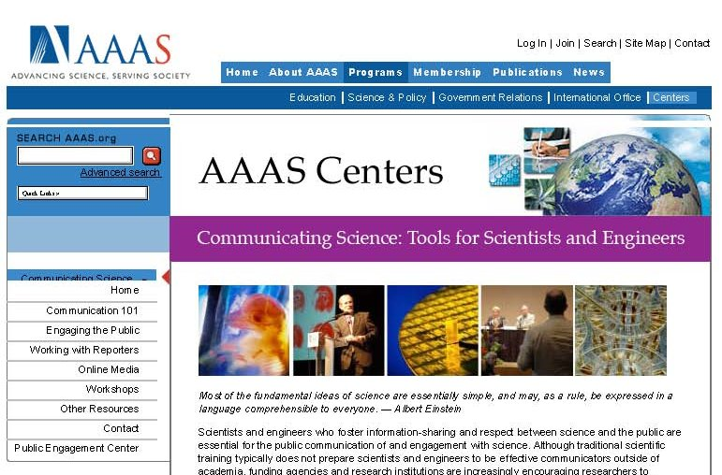
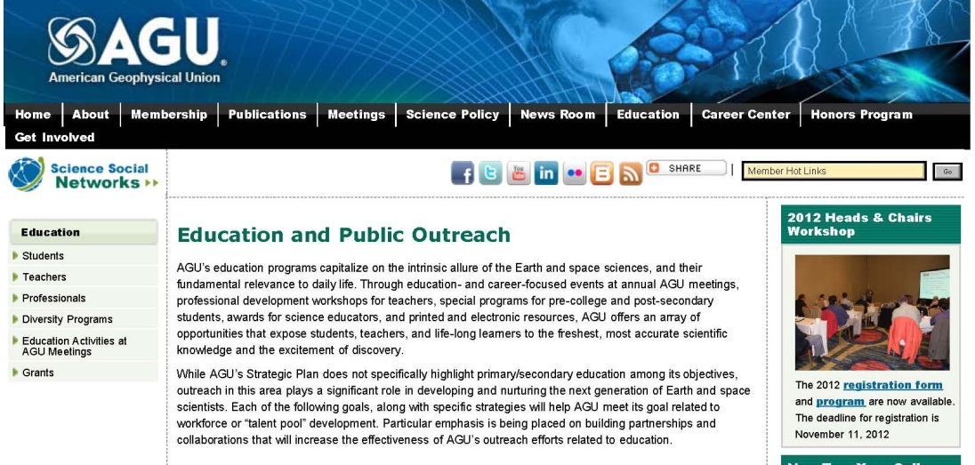
Broader Impacts
Potential to benefit society and contribute to the achievement of specific, desired societal outcomes.
Notes:
Scientists also are now required to produce what is called “broader impacts”, or efforts to deliver their research in a way that gets it to other audiences, to benefit society. NSF requires broader impacts as part of its grant applications, and the requirements for Broader impacts have become more specific and tailored in recent years. There is now a national association for broader impacts, and faculty members are not allowed to just list a graduate student as their broader impact. At VIMS, scientists are coming to educators, looking for ways to connect their research to other audiences including K12, teachers, and the general public. This could be through curriculum writing, professional development, exhibits and displays, or public lectures. OUtreach has become an important part of a scientists world, as you can see by the emphasis on some of these scientific organization websites.

Slide 4
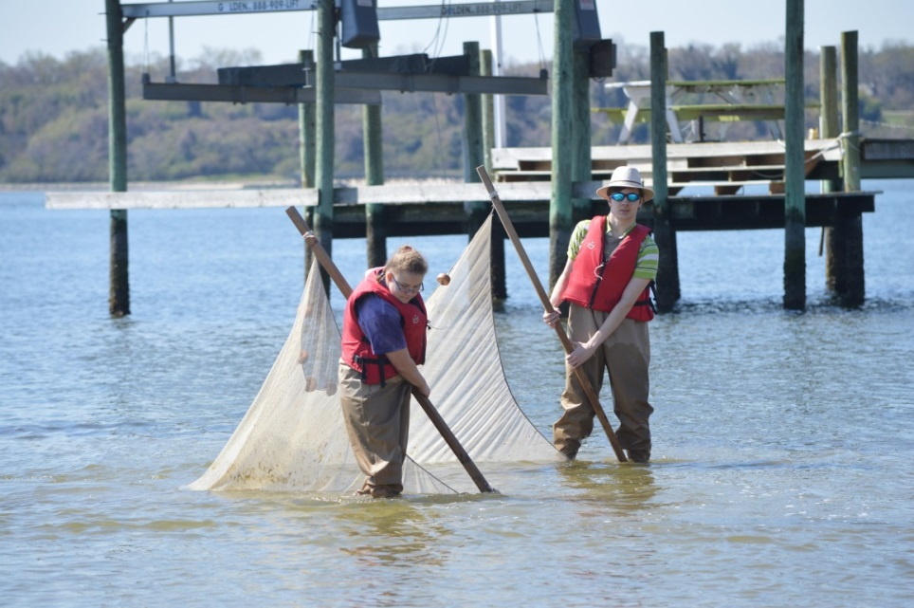
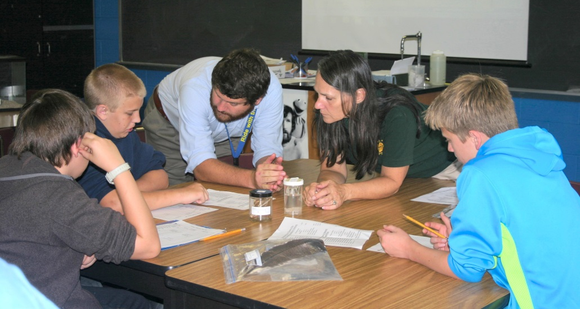
Virginia Scientists and Educators Alliance
VIMS Education Teams
Hands-on, investigative field experiences, curriculum and information material, teacher training, and public outreach events
North Carolina SciREN model
Virginia Scientists and Educators Alliance
Created by graduate students at UNC Institute of Marine Sciences and the SciREN teams now include graduate students NC universities.
Collaboration between Virginia science graduate students and K-12 science teachers to produce classroom lessons based on current research
Notes:
So given that information, and given the experiences and expertise of VIMS educators, we developed VA SEA, or the Virginia Scientists and Educators Alliance. A little history first. VIMS and CBNERR educators have developed many programs over the years, including field experiences for students, teacher professional development, curriculum, and public outreach. We have been delivering programs to increase scientific literacy for many years. One of those programs, run by my colleagues at VIMS Marine Advisory Program is the GK12 project which placed marine science graduate students in local secondary science classrooms. The graduate student worked with a mentor teacher, enriching the science curriculum with their own expertise and background, and serving as a role model for scientific careers. Unfortunately, funding for this program ended, and VIMS was looking for a way to continue it but with perhaps a smaller price tag. Around the same time, we came across a program in NC called SciREN which was created by graduate students at UNC, and had graduate students create lesson plans that were offered to teachers statewide. After attending one of their lesson plan expos, We saw the results and enthusiasm of both the teachers and the students in SciREN, and applied for funding to start a similar program in Virginia, which is where VA SEA was created.

Slide 5
Objectives
Enhance graduate student science communication by providing pedagogical skill training and an opportunity to translate their research into activities for secondary classrooms.
Enhance K-12 science curriculum by providing teachers with resources that offer authentic examples of research process and how science is applied to solve problems.
Notes:
The objectives of the program were two-fold. One, we wanted to train graduate students to communicate their research at a level that most people could understand. Scientists are required to share their research in quite digestible soundbites, and this was a perfect way to distill it down.
Secondly, we wanted to increase the research skills that students were able to practice, by getting current research into the hands of teachers so that they could be used with students. For example, some of the lesson plans that were created focused on the process of science itself, such as how to conduct random sampling.

Slide 6
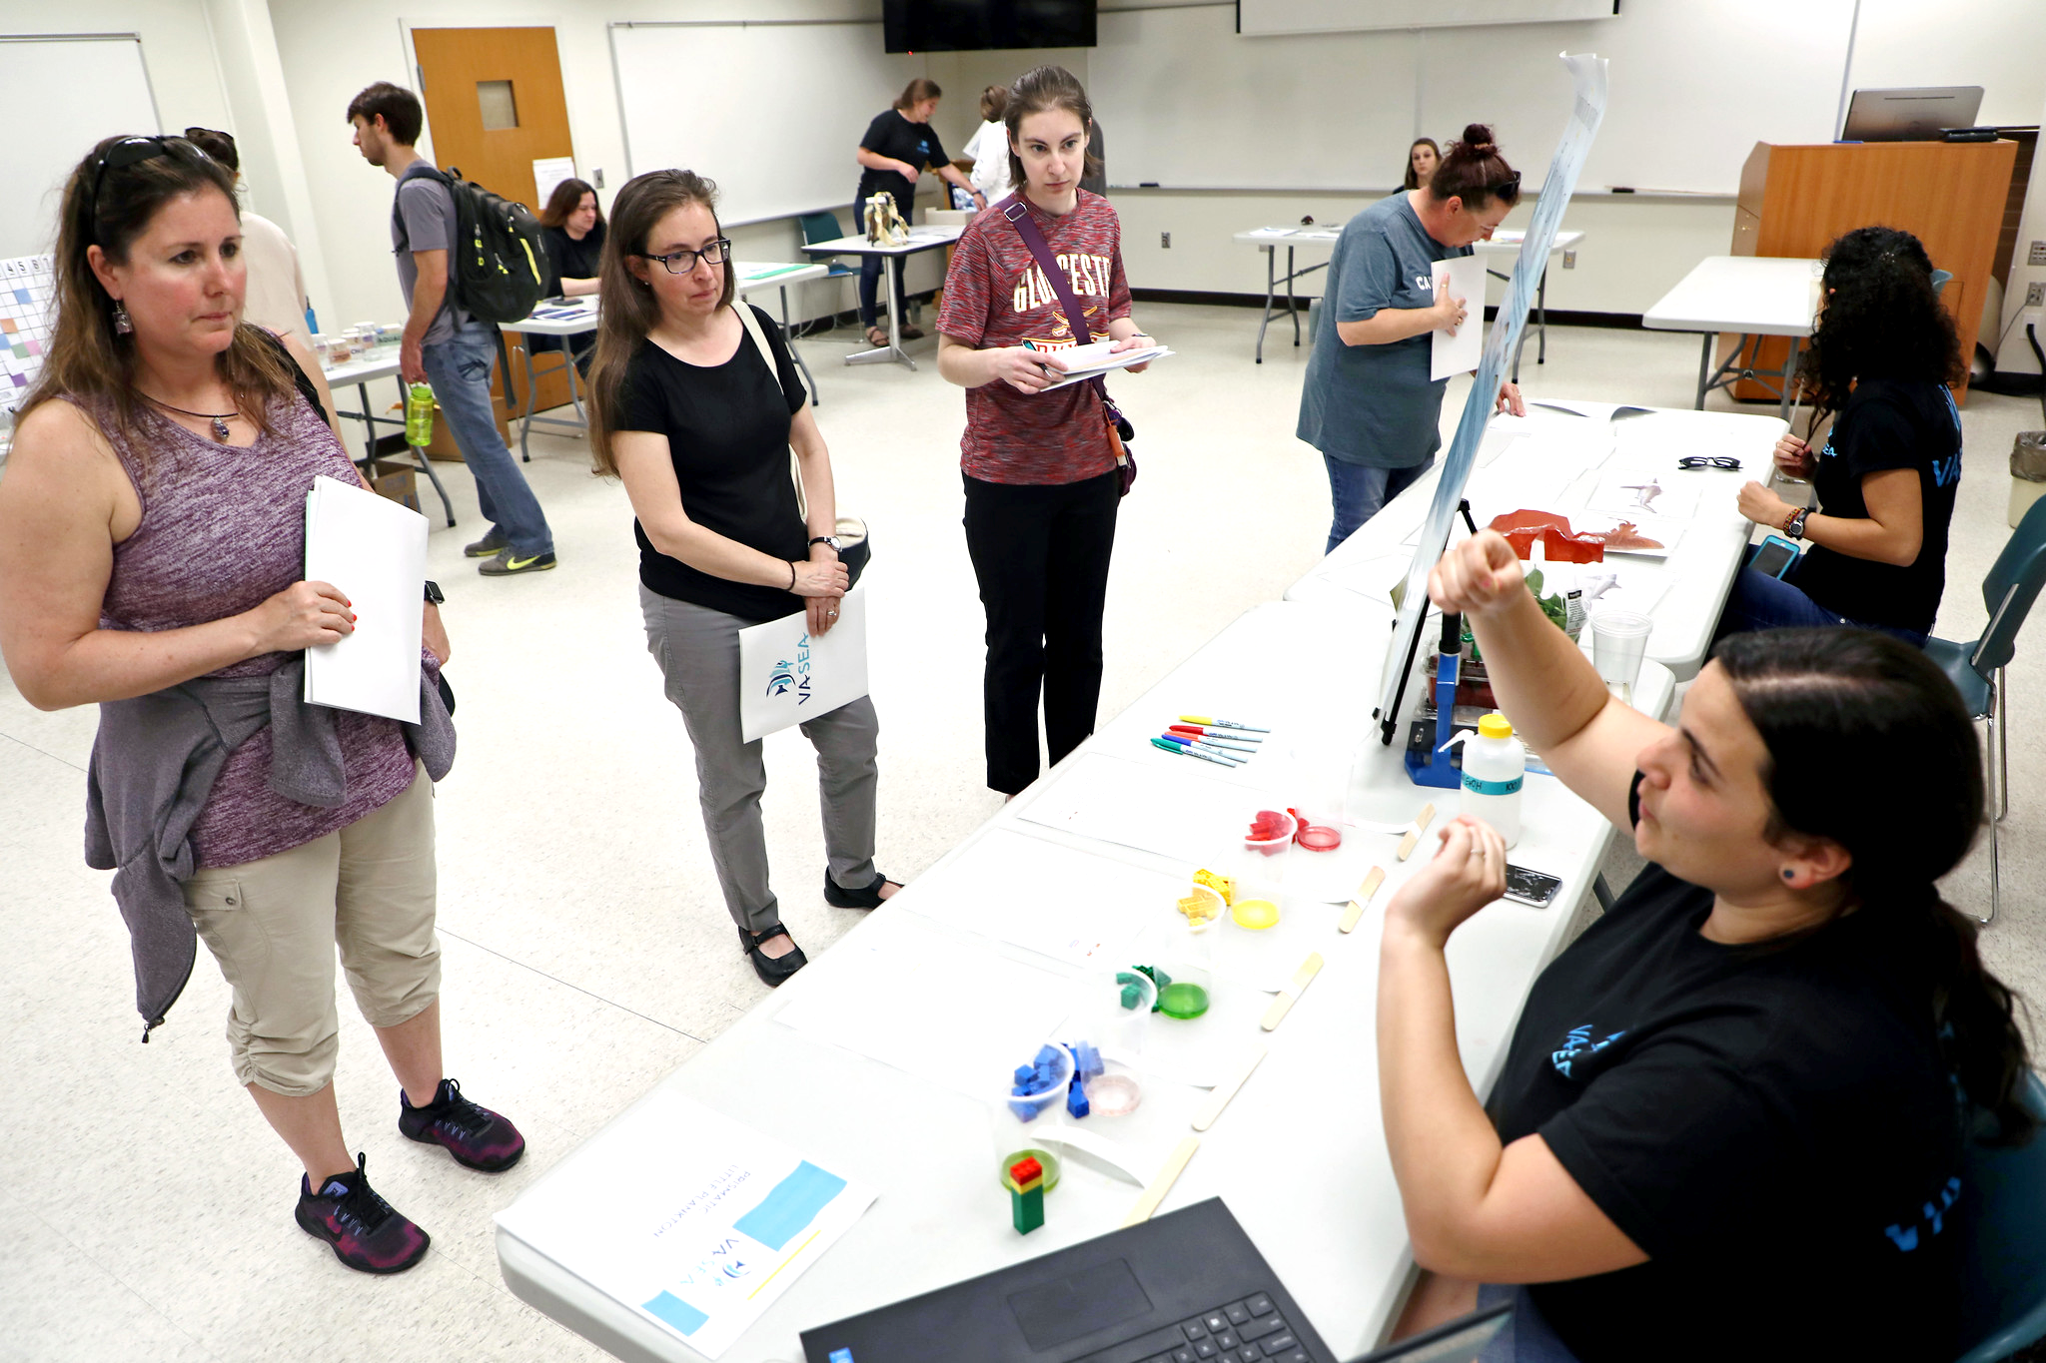
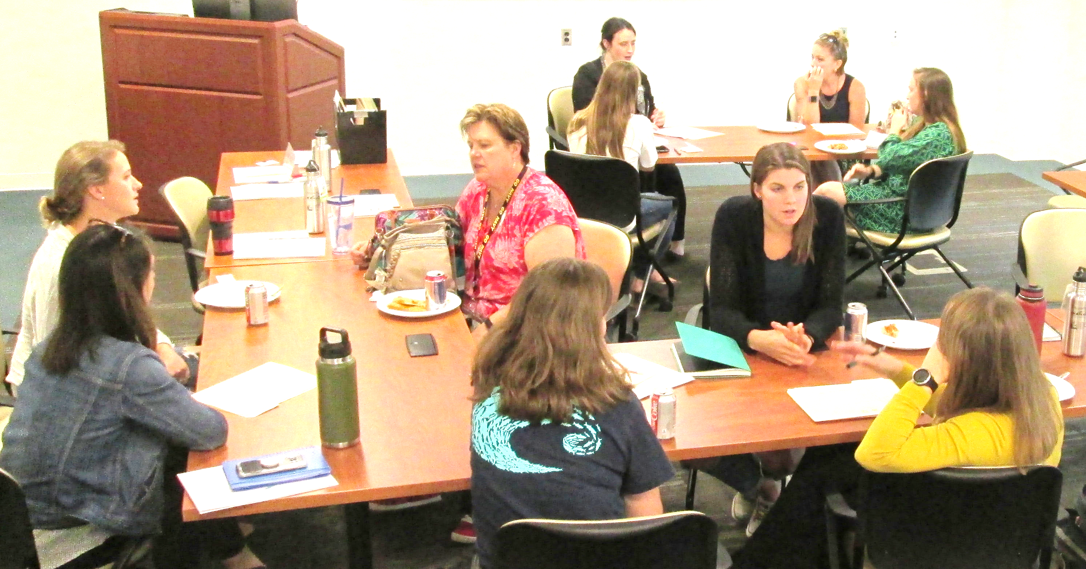
Project Timeline
Student recruitment; Application review; and Lesson Plan Development workshop
Teacher reviewers tested lesson plans in the classroom and provide feedback
Sept
Jan-Feb
Nov-Dec
Mar-Apr
Draft lesson plans reviewed, edited, and paired with local teacher
Final edits to lesson plans and Lesson Plan Expo open to teachers statewide
Notes:
This is a sample timeline: In September, we offer graduate student training in lesson plan development. Students submit a lesson concept by the end of September. They attend at least 1 of 3 “check-in” meetings in October so we can discuss their progress and problem-solve. The draft lesson plan is due in mid-November. The Educator Team reviews the lesson plans, asking for clarifications or revisions, as needed. Then, the lessons are paired with a secondary science teacher who has agreed to pilot test the lesson plan in their classroom between Jan-Feb. Using the teacher’s feedback, the graduate student makes any changes needed during March, and we host the Lesson Plan Expo in April, inviting teachers from across Virginia & nearby regions.
The compilation of resources has been invaluable to both CBNERR education programs, but also to our partner, VIMS Marine Advisory Program, and together, we have presented or demonstrated one or many lessons from the collection 18 times for over 1,200 students and teachers in the past two years. The lesson plans have been shared at local, regional, state, and national conferences too.

Slide 7
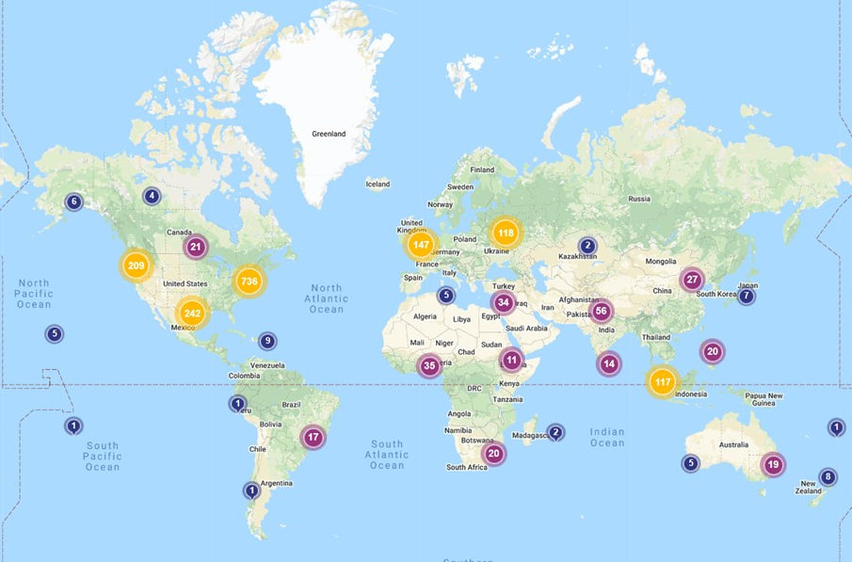
Since April 2018: 1992 downloads from 90 countries
per College of William & Mary ScholarWorks, Digital Commons Dashboard
Notes:
After the Lesson Expo, final polishing and formatting take place and the lessons are posted on VIMS website and William & Mary’s ScholarWorks. Each receives a doi number and qualifies as a publication.
ScholarWorks Rpt 2/5/20: We receive reports about how often and where the activities are being downloaded. The lesson plans are not advertised except through our own programs, conference presentations, and through our website. So it is pretty remarkable to see how far the VA SEA resources have reached.

Slide 8
Lesson Plan Design Basics &
Best Practices:
What do teachers do?
What they need to accomplish
What content & skills mastered
What teaching method
Materials needed
What do they need to replicate your lesson/activity?
ALL that information
Recognizable format
Standardized Format
What goes into a lesson plan?
◦ Who & Why?
◦ What & How? ◦ So What?
Notes:
Certainly, the timeliness and relevance of many of these research topics accounts for the interest. But, the lesson structure is also important. To make your research useable to teachers, as end-users/constituents, you want it to line up what you’ve done with the concepts, content & skills they need to teach. And, you need to be aware of the best practices for structuring the lesson that will make it most effective.
Teachers develop lesson plans that lay out:
what they need to accomplish, does a lesson complement/enrich their curriculum?
what content or skills students will learn/master
what teaching methods will be used
What materials they need, all the nuts and bolts!
You’ll want teachers to be able to completely recreate your lesson idea in their classroom, so you want them to easily recognize in your lesson all the planning elements they use in designing their own lessons.
So we are following a standardized format that is similar to many templates teachers use.
Let’s run through a lesson that has been very successful and debrief on the structure afterward.

Slide 9
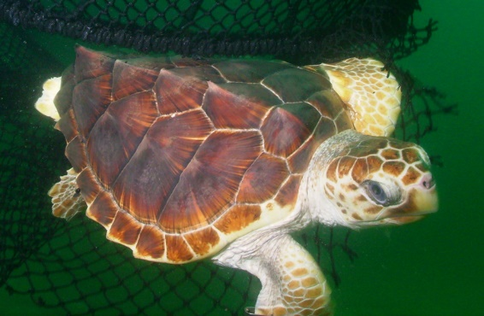
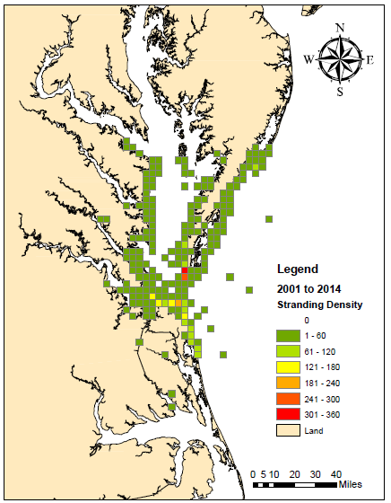
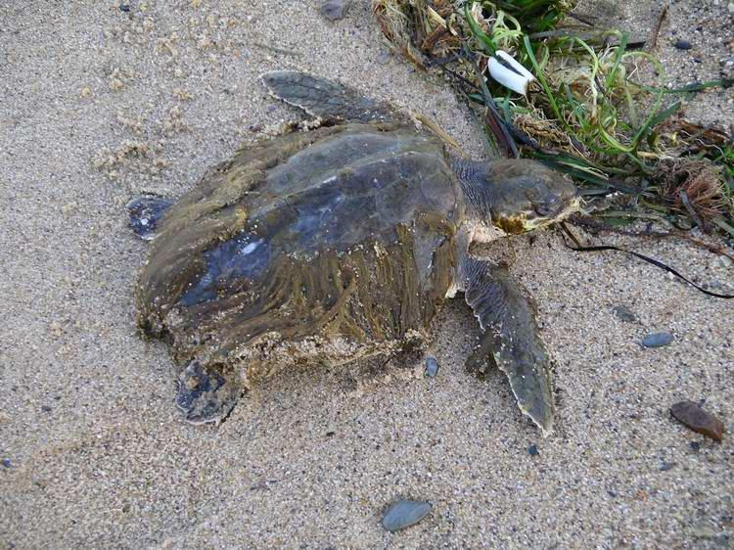
Sea Turtle CSI – VIMS Case Study
Loggerheads use the Chesapeake Bay as nursery and feeding habitat.
Each year, 200-400 turtles are found stranded on Bay beaches.
Scientists want to understand sources of sea turtle injury/death to identify deadly “hot spots.”

Slide 10
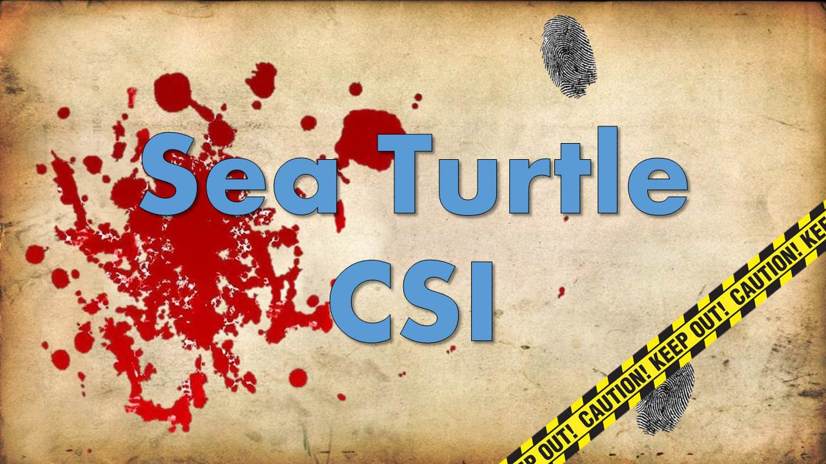
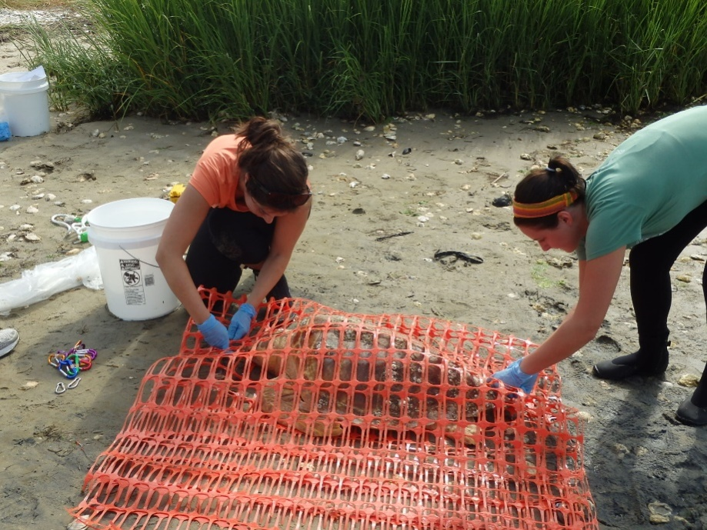
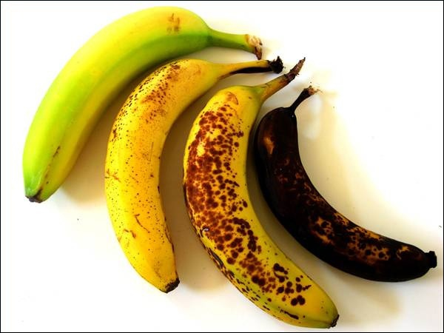
Sea Turtle Decomposition Study
Using a forensic approach – graduate student Bianca Santos treats a turtle stranding like a crime scene investigation.
1st: Determine how long ago the turtle died. To do that you need to know how long it takes for a turtle’s body to decompose.
Notes:
Just like crime scene investigators who determine how long ago a death took place, Bianca needed to know how long it took for a turtle’s body to decompose. Based on her research and working with her GK-12 Partner Teachers, she developed a lesson that involved students in a CSI study of the stages and rate of sea turtle decomposition.
Teams of students received different “case files,” each containing photos of a dead sea turtle as evidence. Each team assigned a condition code (state of decomposition) to their case, based on standard criteria. Then teams reviewed one another’s rankings and reconsidered the status of their own case. After refining their rankings, teams contributed data to a graph of decomposition as a function of time to produce a rate of decomposition.

Slide 11
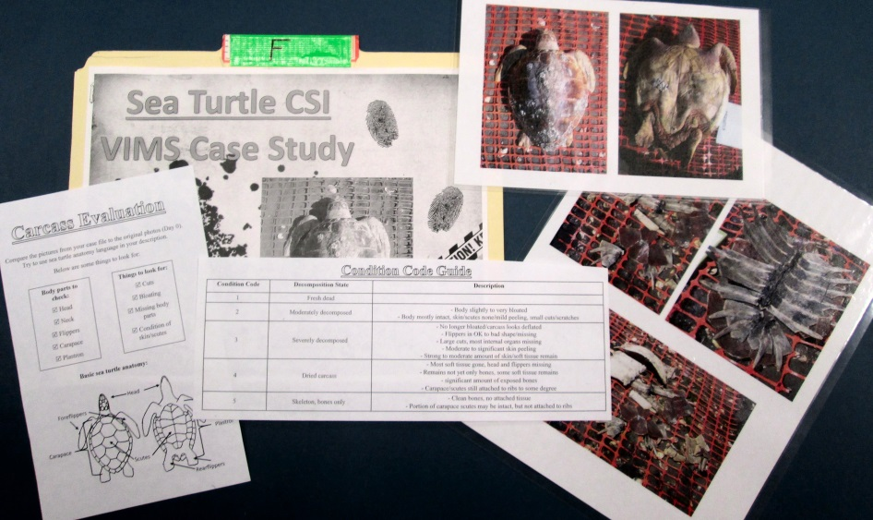
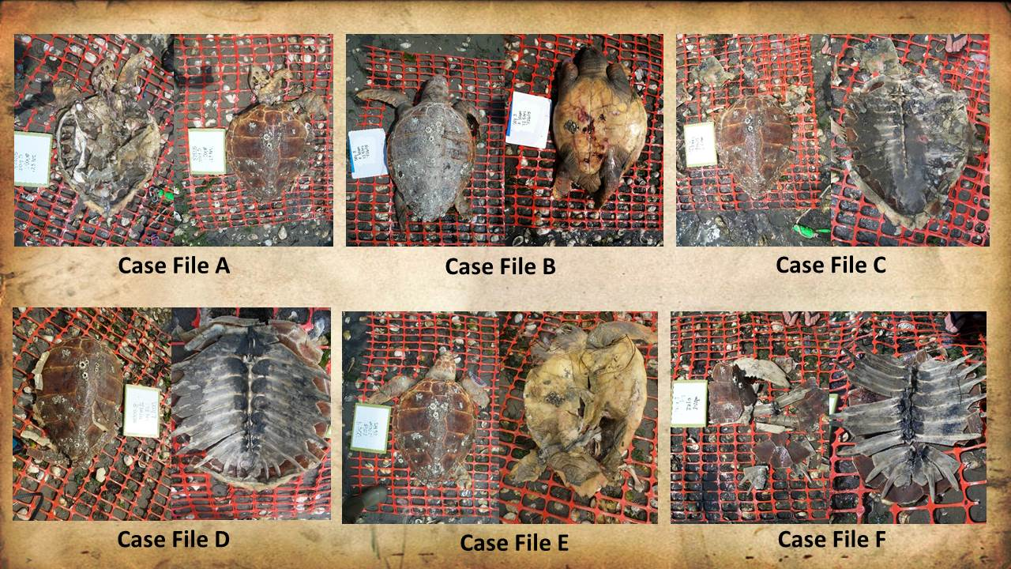
Sea Turtle Decomposition Study
Each team gets a Case File.
Compare your case photos with images of a freshly dead carcass.
Use the carcass evaluation criteria & Condition Code Guide to assign the Condition Code.
Condition Code | Carcass State
0 | Alive
1 | Fresh dead
2 | Moderately decomposed
3 | Severely decomposed
4 | Dried carcass
5 | Skeleton, bones only
Notes:
Just like crime scene investigators who determine how long ago a death took place, Bianca needed to know how long it took for a turtle’s body to decompose. Based on her research and working with her GK-12 Partner Teachers, she developed a lesson that involved students in a CSI study of the stages and rate of sea turtle decomposition.
Teams of students received different “case files,” each containing photos of a dead sea turtle as evidence. Each team assigned a condition code (state of decomposition) to their case, based on standard criteria. Then teams reviewed one another’s rankings and reconsidered the status of their own case. After refining their rankings, teams contributed data to a graph of decomposition as a function of time to produce a rate of decomposition.

Slide 13
Graphing Activity
Case File | Condition Code | Day
 |  | 0
A
B
C
D
E
F
Condition Code | Carcass State
0 | Alive
1 | Fresh dead
2 | Moderately decomposed
3 | Severely decomposed
4 | Dried carcass
5 | Skeleton, bones only
3
2
4
4
3
5
3
1
4
5
2
6
Notes:
Key information: Sampling took place each day for 6 days. Two pairs of case studies with the same condition code.

Slide 14
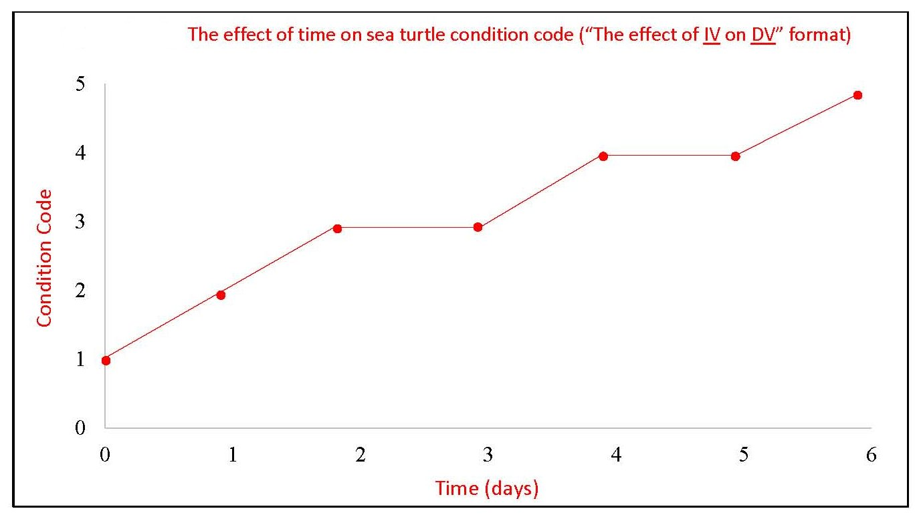

Slide 15
The Learning Cycle / 5E Model:
Lesson design to address more of the ways
in which people learn.
People learn differently.
Diverse kinds of experiences contribute to learning and understanding.
“Authentic” experiences and problem solving make learning more active rather than passive.
Students need time to process, apply and reflect on what they have learned.
Learning is a cycle!
Notes:
One of the things that makes this lesson effective is it’s structure. Educational research demonstrates that: people learn differently & including different kinds of learning experiences in a lesson contribute to effectiveness. In particular, authentic/problem solving experiences that make learning more active. And, students need time to think about, work with & practice what they learn. One of the most widespread structures that has emerged from this is the Learning Cycle, it’s not just what you teach, but the order in which you present experiences, content, practice and reflection.
Research based on learning shows that the order of lesson elements matters. The Learning Cycle or 5E Model is a lesson structure that helps address more of the ways in which people learn.
*All people don’t learn and understand in the same way.
*People need different kinds of learning experiences to help them learn and understand new information.
*Emphasize “authentic” experiences and problem solving so that learning is active rather than passive.
*Allow time for students to process, apply and reflecton what they have learned.
Learning is really a cycle!

Slide 16
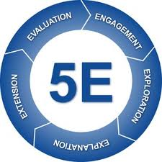
The 5E Model
Engagement =
Students relate past & present learning,
mentally focus/engage on what is to be studied
Exploration =
Students actively explore or manipulate, provides common base of
experience, students identify & develop concepts/processes/skills Explanation =
Students verbalize understanding or demonstrate skills,
teacher introduces terms, definitions & explanations Elaboration =
Extends student understanding & allows practice,
develop deeper/broader understanding
Evaluation =
Learners encouraged to assess their
understanding & skills, teacher evaluates
Notes:
The cycle is sometimes shown with 3 steps, or 4.
Today, the most wide-spread version of the Learning Cycle is called the 5E Model, it adds evaluation/assessment. It is a great way to think about the structure of your lesson plan, and kind of an “industry standard” among science teachers these days – heavily promoted at educator conferences.
See the back of the 5E handout for details on these stages – developed initially by Bybee et al and used in the BSCS (biological science curriculum study) science curricula that many of us experienced in high school.
Engagement or Invitation: To find out what students know and prime them for the subject at hand. Offer a question or quick problem to research or solve. Could be an observation, watch a demo or a quick hands-on experience to set the stage for learning.
Exploration: Open-ended experience, first-hand experience of phenomena, followed by discussion of discoveries, ideas or questions that arise. Creating a need to know.
Explanation: After you’ve focused student interest and attention & have found out what they understand… Then introduce the information, concepts or methods they will use to solve problems & build understanding.
Elaboration or Application: You want the students to put their understanding to work, to practice - perhaps on another activity or challenge. Students think & discuss, take a more active role in reflecting on what they have learned.
Evaluation: This allows both the students and the instructor to see if they “got it,” an activity to assess their understanding & skills. Not just a quiz administered by teacher.
So, as you design a lesson plan, think about these steps. They don’t always have to be in exactly this order. And, there may actually be multiple cycles within a lesson. An quick lab or demo may lead to explanation, then back to another quick lab. Or, on to elaboration.
There are quite a few ways to organize these elements within the learning cycle or 5E model. For some additional ideas, especially those that promote student participation, see the reading on cooperative learning that is in the digital resource collection.

Slide 17
Sea Turtle CSI in
the 5E framework
Engagement =
Exploration =
Explanation =
Elaboration =
Evaluation =
Notes:
For Sea Turtle CSI: what are some of these steps in the cycle?
Engagement or Invitation: To find out what students know and prime them for the subject at hand. Offer a question or quick problem to research or solve. Could be an observation, watch a demo or a quick hands-on experience to set the stage for learning.
Exploration: Open-ended experience, first-hand experience of phenomena, followed by discussion of discoveries, ideas or questions that arise. Creating a need to know.
Explanation: After you’ve focused student interest and attention & have found out what they understand… Then introduce the information, concepts or methods they will use to solve problems & build understanding.
Elaboration or Application: You want the students to put their understanding to work, to practice - perhaps on another activity or challenge. Students think & discuss, take a more active role in reflecting on what they have learned.
Evaluation: This allows both the students and the instructor to see if they “got it,” an activity to assess their understanding & skills. Not just a quiz administered by teacher.

Slide 18
Featured VA SEA Lessons
Wolffish: A Tale of Missing Teeth (life cycles & anatomy) Life science/biology, Grades 6-8 Trawling through the 5 Ocean Gyres: A Microplastics Research Study Life science/biology, Grades 6-8 Digesting Data (fish diet & food web impacts) Life science/biology, Grades 6-8
Expedition Sediments: Mud’s Journey through the Watershed (sediment transport) Earth science/environmental science Grades 9-12 Earthquakes, Glaciers & Sediments (sediment cores reveal geological events) Earth science/ environmental science Grades 9-12
Notes:
We have 5 other VA SEA lessons to briefly share. They all replicate some aspect of the grad students research: experimental design, sampling methodology, recording and organizing observations/measurements, data analysis and interpretation – often graphing, discussion, synthesis and drawing conclusions.

Slide 19
Session Procedure
Break into groups.
Rotate through each station for hands-on demonstration of the activity.
8 minutes per station.
Come back together for discussion & wrap-up.

Slide 20
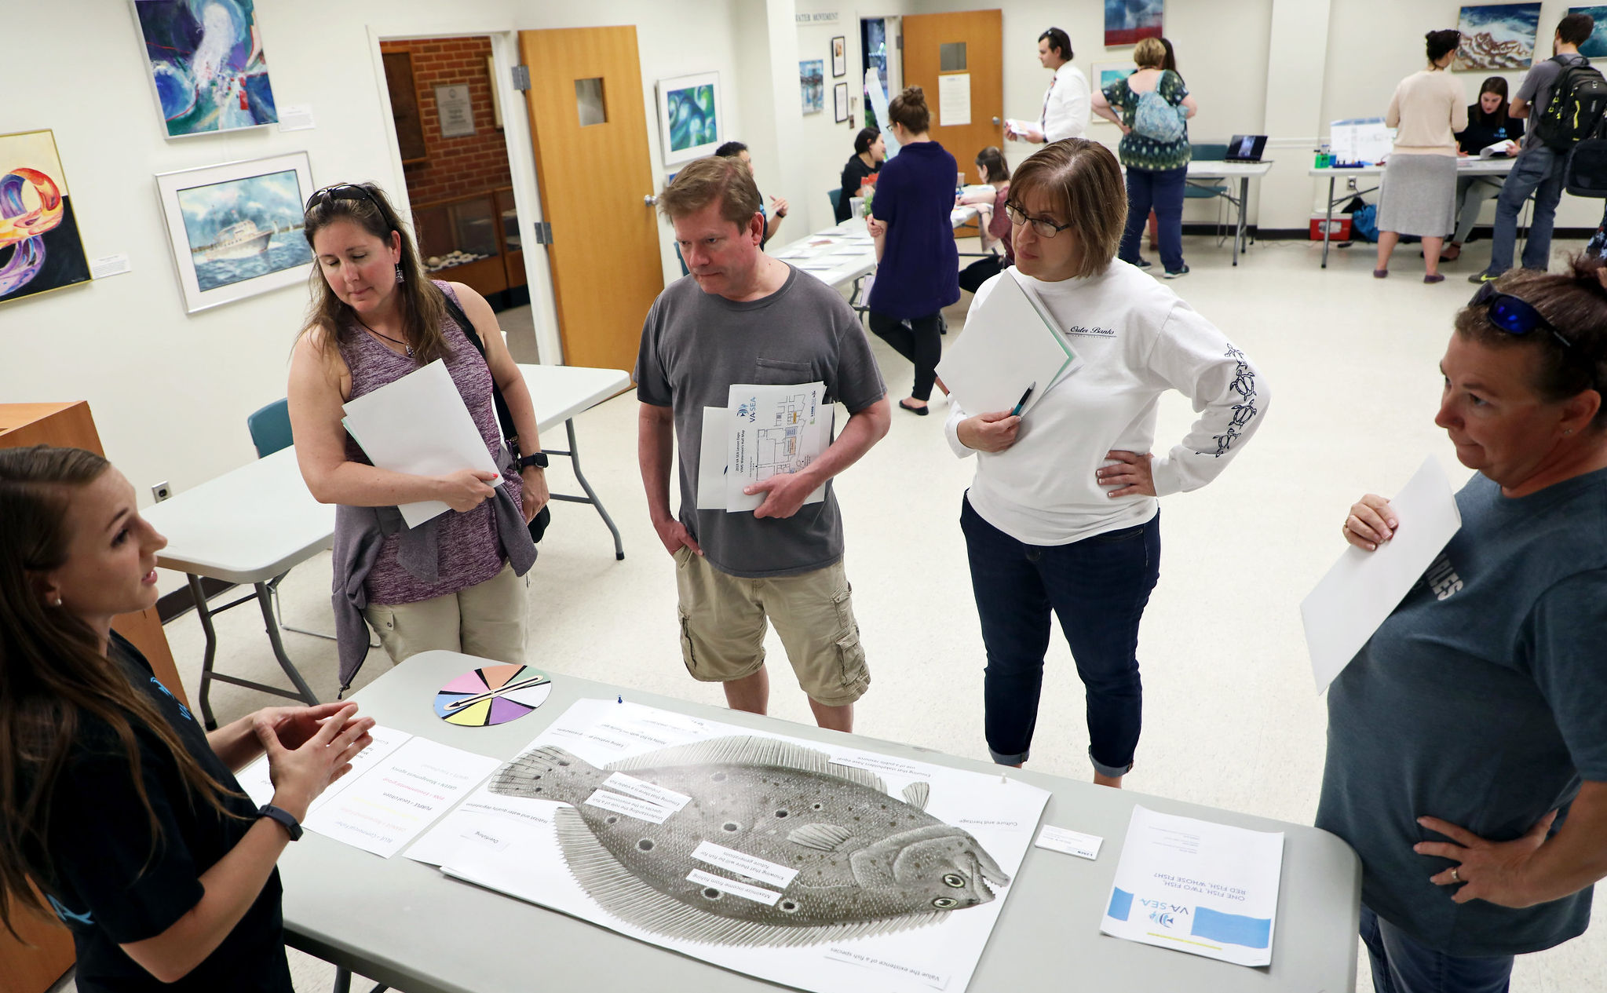
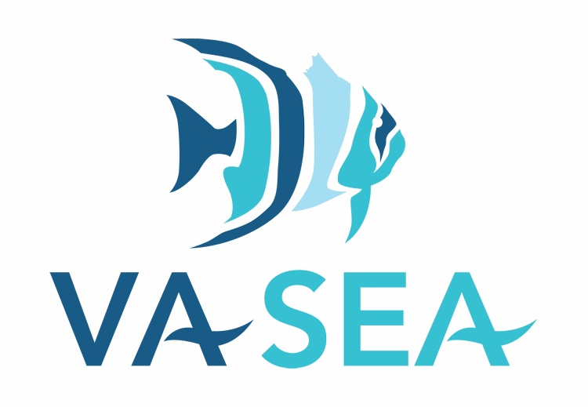
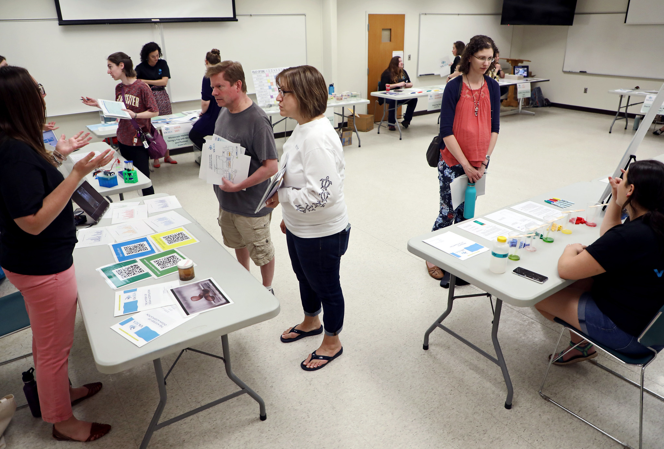
tinyurl.com/vasealessonplans

Slide 21
Thank you!
Lisa Lawrence, Education Leader
Marine Advisory Program/Virginia Sea Grant @ VIMS
ayers@vims.edu
Carol Hopper Brill
Marine Advisory Program/Virginia Sea Grant @ VIMS
chopper@vims.edu

